Slide 1
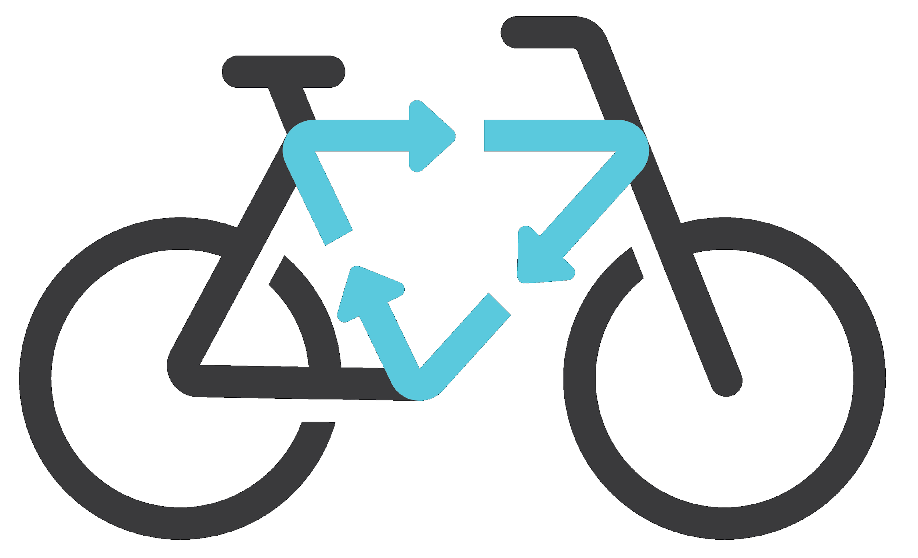
MUM Bicycle Management System

Slide 2
Problem
In the past few years Mum had faced some problems in managing bicycles, a lot of bikes are almost everywhere in the campus either broken or left unused in a good shape, so we had think of a system that manage these bicycles either by renting it or transfer it to a new comer or recycle it if it is broken and that will benefit both the original owner and the university

Slide 3
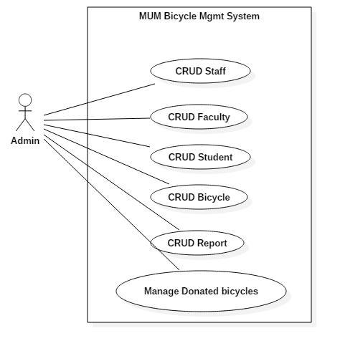
UseCases

Slide 4
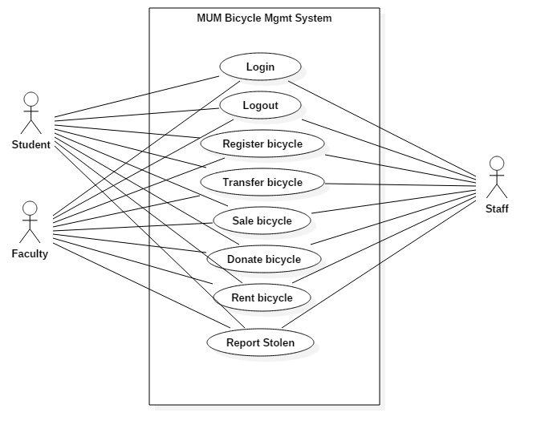
UseCases

Slide 5
Actors Admin
Preconditions
The admin must logged in to the system
Flows of Events:
1. Basic Flows
1.1.0 Create Student Profile
Step | User Actions | System Actions
1 | The admin select student from user type main menu | The system displays Student registration form
2 | The admin fill the form and click submit button | The system validate student information if successful save it and redirect to confirmation page else it displays unsuccessful page
Postconditions
The student profile is persisted in the system
Business Rules
No duplicate student profiles. A unique profile is identified by email address

